Slide 1
W7: P-value
Yue Lin
Ph.D. student in Political Science
University of California, Berkeley

Slide 2
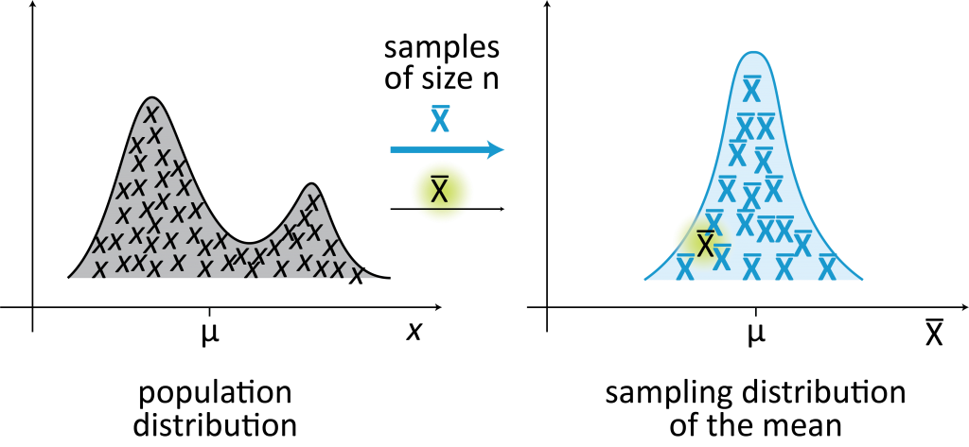
Sampling Distribution
a.k.a. the distribution of the means of each sample
No matter type of distribution from the population → Sampling Distribution will always have a Normal Distribution (bell shape) with specific characteristics of the distribution of data.

Slide 3
Hypotheses
Null: The treatment has no effect.
The null usually says that nothing happens.
Assume the null explains the world, unless proved otherwise.
Alternative: The treatment has positive/negative/some effect.
This alternative is usually what we predict what would happen, if there was a treatment effect.
Our question to ask: “Does the evidence we collect make our null hypothesis look ridiculous?”
Notes:
Great explanation: https://medium.com/hackernoon/statistical-inference-in-one-sentence-33a4683a6424

Slide 4
P-value
P-value is the probability we would see an estimate as large as or larger than the one we did, if the treatment had no effect.
A small p-value:
There’s low probability that we would get this large or a larger estimate if there was really no treatment effect in truth.
When do we say that the estimate is statistically significant?
If p < 0.05, we say the estimate is statistically significant. It means that the probability of getting this large or a larger than this estimate is < 5%, if there was really no treatment effect.

Slide 5
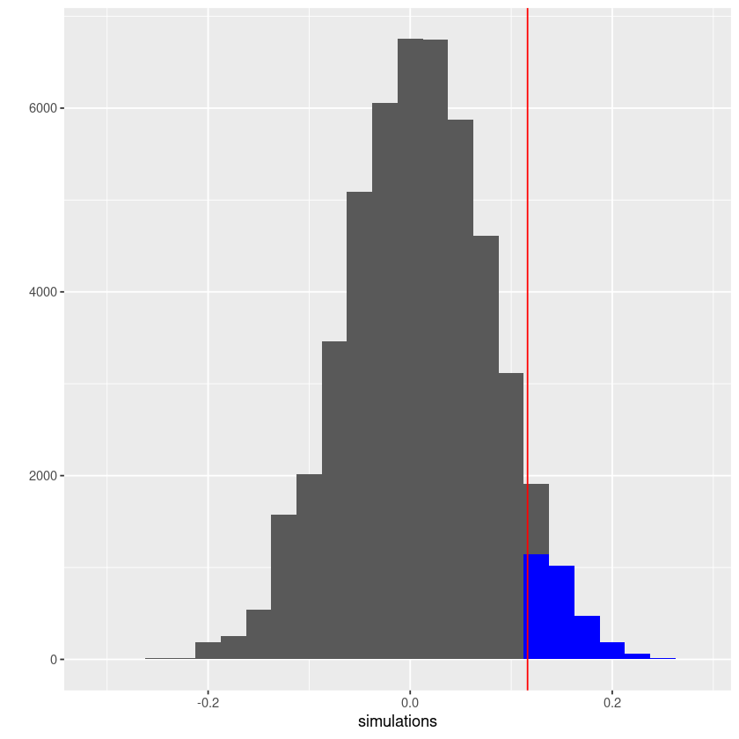

Slide 6
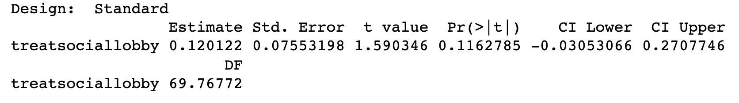
P-value
Related to t-score: if t < -1.96 or t > 1.96, the corresponding p-value is low, and the result is statistically significant!

Slide 7
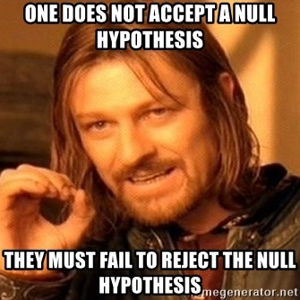
What the p-value does not tell us
We cannot accept the null/confirm with total certainty an effect.
We cannot accept the alternative hypothesis even we find a statistically significant result.
It is not the probability of treatment having an effect.

Slide 8
Let’s now head over to the Notebook and code!

Slide 9
Caveats on the research proposal! A few common problems…

